Slide 1
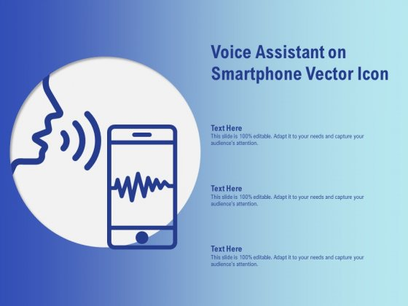
FedEx Voice Assistant
TRACK
or
Get Quote

Slide 2
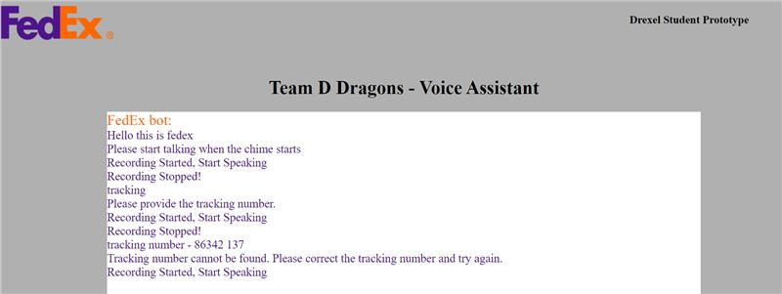
Let the Assistant work for you.
TRACK
Lets you track your package with your voice using FedEx Tracking API.

Slide 3
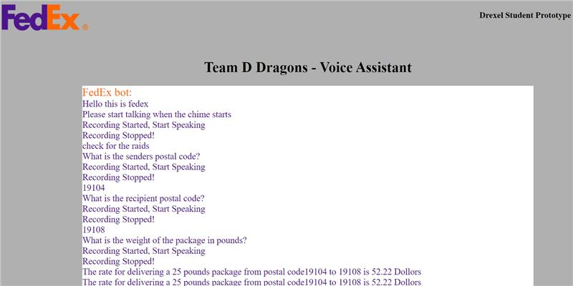
Let the Assistant work for you.
Get Quote
Lets you get the quote for sending a package from one address to another using using FedEx Rate Quotes API.

Slide 4




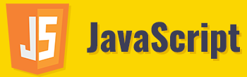
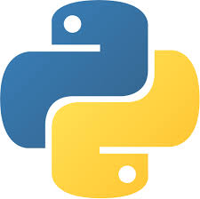
Voice Assistant Architecture
User
FedEx
Track and Rate Quote
API’s
+
Speech recognition
Voice to Text Conversion
→
Tokenization
Check for the API and respond
Text to voice conversion

Slide 5
Design Flow and Data Pipeline
This app uses the Django framework and it communicates with the two FedEx APIs (Track and Rate Quotes).
The app is deployed as a Django app running in Heroku Server.
Frontend is created using JavaScript.
The data pipeline receives real-time voice data from the user, which it converts to text and tokenize the sentences, Lemmatize, create the bag of words, and calculate the similarity of the words in the query.
It will connect to the respective API, get the response and convert back to the voice and sends to the customer.

Slide 6


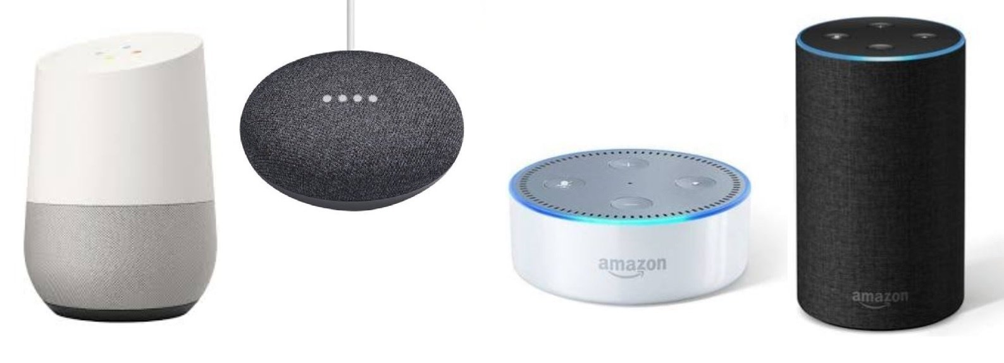
Use cases
Can be used along with current chat bot used in Fedex website to provide the customer with an option to speak or type to interact.
Can be used to retrieve information from cloud-based voice assistants like Google assistant, Alexa, Siri, Cortana etc.
Can be used as a separate application which can be embedded into any website and use the functionality.

Slide 7




FedEx Voice Assistant
Business Goals
Team ( DDragons )
Content Library
Business Value: We want to increase the ways users can use your services, faster and easier. Rather than using the services in a browser, we let the users interact with the services directly using their voice.
Data Scientist Lakshmi kanth Peddinti| akumar2109@dxc.com (Applied AI CoE Intern & Drexel Student)
GitHub Repo: Click Here
Video / Demo: Click Here
Backend Developer Sudharashan Rao Balaji| dpeddinti@dxc.com (Applied AI CoE Intern & Drexel Student)
Technical Innovation: A voice assistant application that can take your voice inputs and provide back with the correct information through voice.
Presentation: Click Here
UI Developer Rameshwar Gupta| ffonseca20@dxc.com (Applied AI CoE Intern & Drexel Student)
Business implementation: This application is designed in Python, Django, and deployed in Heroku. It uses Tracking and Rate Quotes API's from FedEx portal and provides the information to the users.
Developer and Designer Sumit Anand| achaudhary42@dxc.com (Applied AI CoE Intern & Drexel Student)

